Slide 1

Electrical Workshop
Session One
9/22/2014
Notes:
Raphael
- Introduce everyone

Slide 2
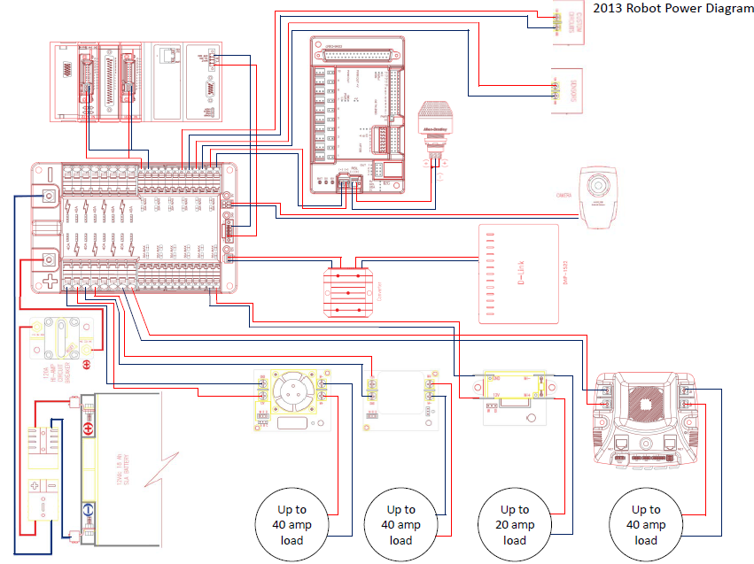
FIRST Power Distribution Diagram

Slide 3
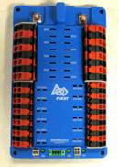
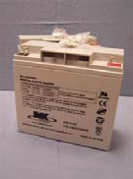
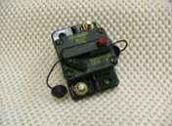
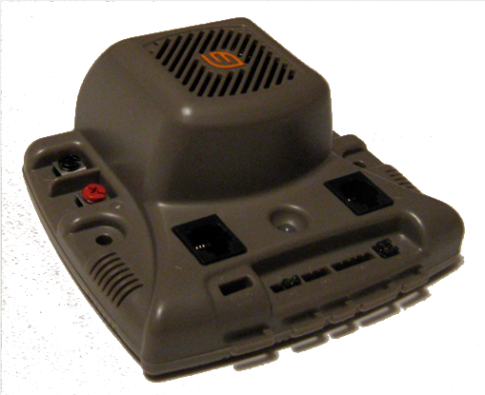
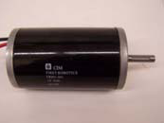
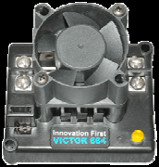
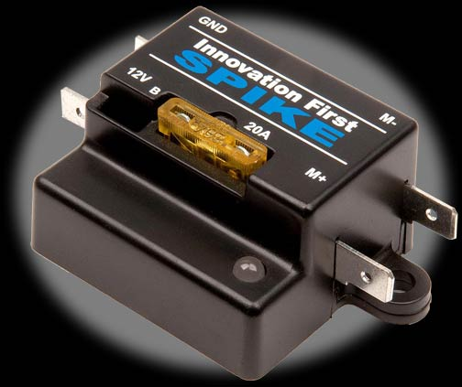
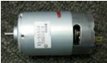
Power Distribution Diagram
18AWG
Speed Controller
100A
6AWG
40A
20A
12AWG
18AWG

Slide 4
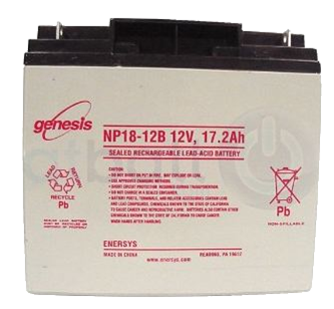
Battery
12V Lead Acid Battery (18Ah)
13 Pounds
Provides over 100 amperes of current. Total output of over 1200 watts of power.
Can supply over 700 amperes of current when terminals are shorted.

Slide 5
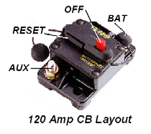
Robot Power Switch
Used to turn robot on and off
Must be easily accessible
Also a 120 amp circuit breaker

Slide 6
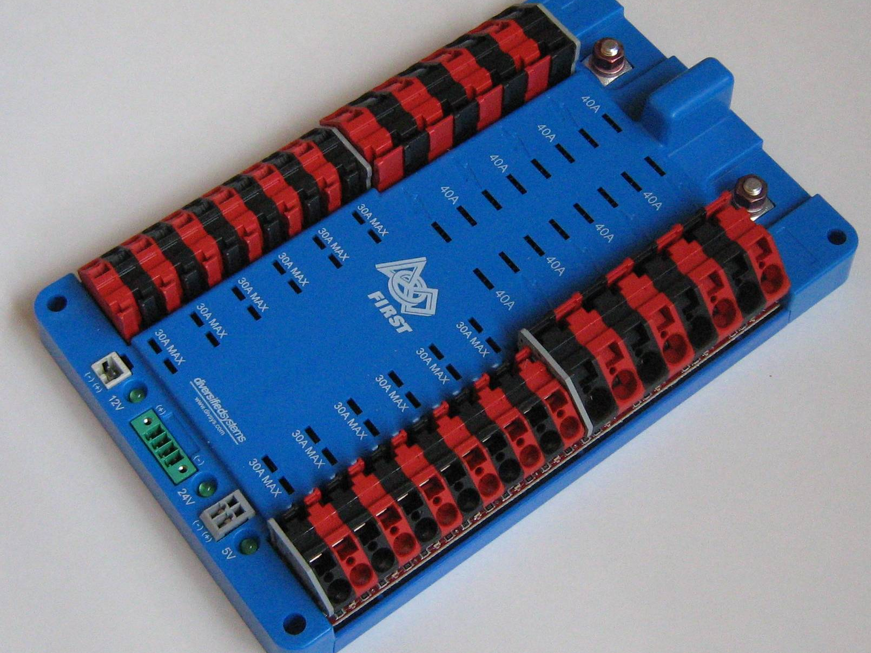
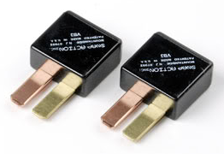
Power Distribution Board
Main Power Connection
20-40 Ampere Fuse Locations
Branch circuit power connection

Slide 7
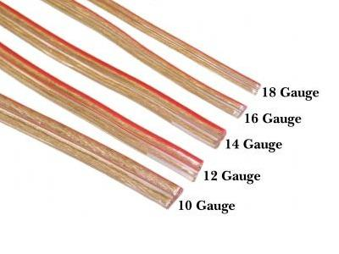
Wires
Wire thickness is based on American Wire Gauge (AWG)
AWG wire thickness is based on the number of wire draws
Higher gauge = thinner wire
Connection type | Wire Gauge
Battery | 8 AWG
30 - 40A circuit | 12 AWG
20 - 30A circuit | 14 AWG
5 - 20A circuit | 18 AWG
cRIO & Controllers | 18 AWG

Slide 8
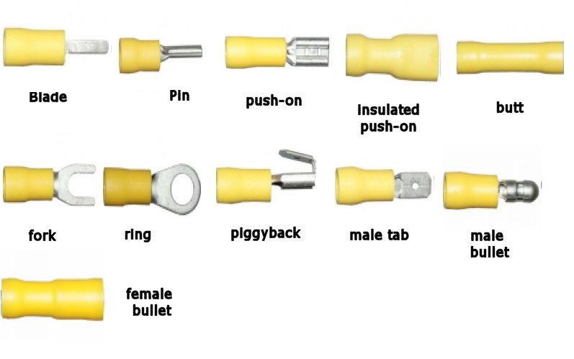
Wire Crimps/Connectors
There are different wire connectors to use depending on what to parts you want to link together.

Slide 9
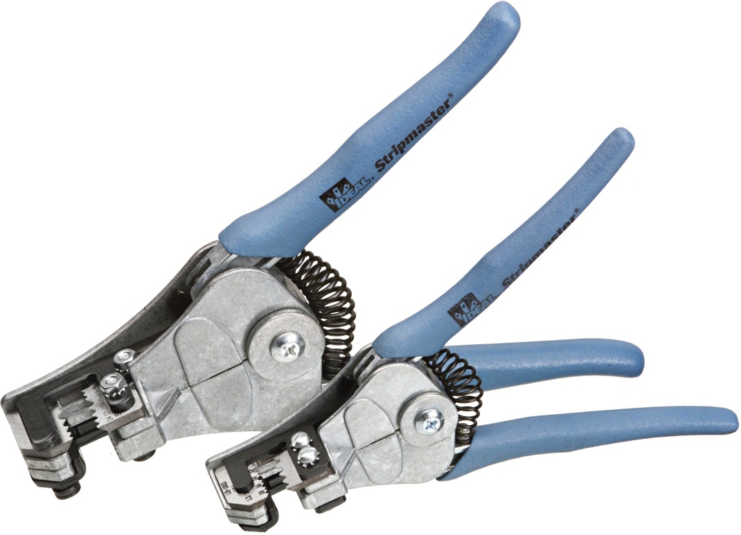
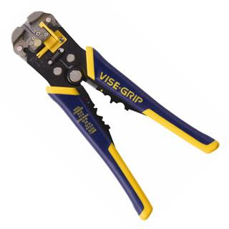
Wire Stripping
Wire must be stripped to put on a connector
Use wire strippers
Strippers have slots for various gauges. Make sure to check which gauge you wish to strip and use appropriate slot.
Careful not to cut the wire while stripping
Make sure to push the handles all the way

Slide 10
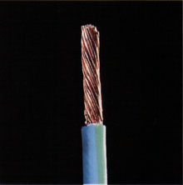
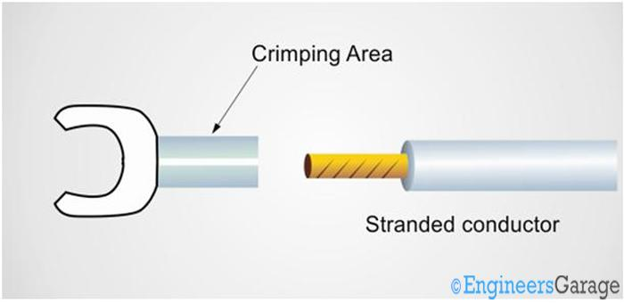
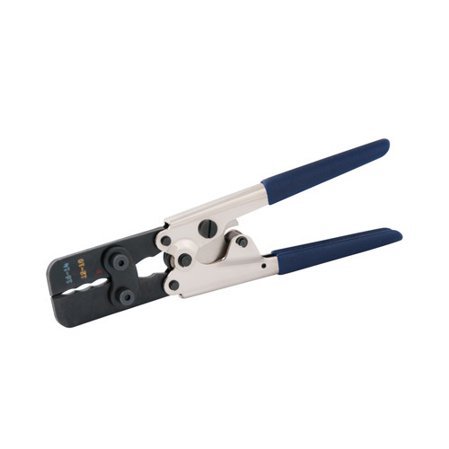
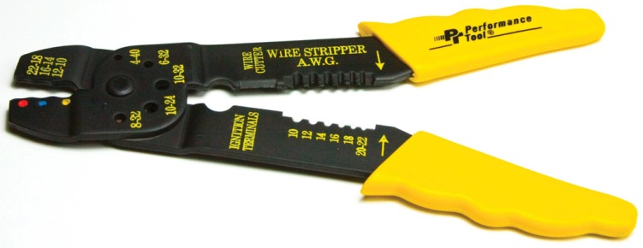
Proper way to put on Crimp
Second: Slide crimp over the stripped part of the wire
First: strip wire
Finally: Using a crimper, squeeze on the crimping area to attach the crimp.

Slide 11
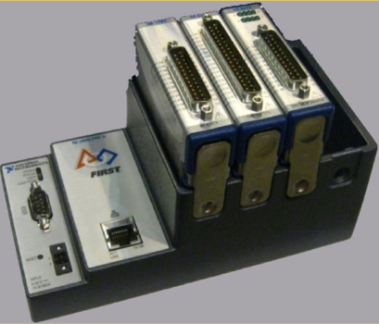
Robot Controller CompactRIO National Instruments Embedded Controller
2013 cRIO; 4 Slots
Power
24V Power via PD Board.
Processor
400 MHz Freescale MPC5125.
Memory
256MB System.
512MB Storage.
Cannot provide enough power to control the motors
So…
The “Brain” of the robot sends control signals to components
Notes:
Servo testers at hobby stores to generate control signal for ESCs
Speaking
Servo is closed loop motor control
Expand ESC
Fix
CPU darkness

Slide 12
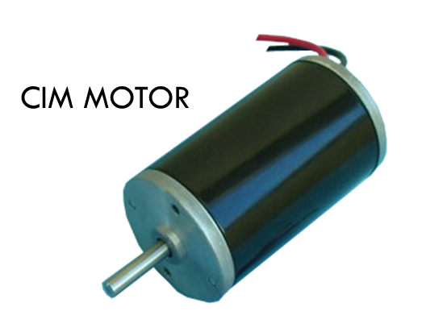
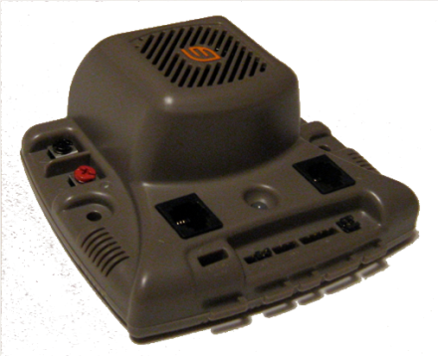
Connections
cRIO
Motor
Motor/Speed
Controller
Copper Wire

Slide 13
Spike Relays
Relays close or open the circuit based on signals from the cRIO.
Meant for smaller motors

Slide 14
How an H-Bridge Works
+12V
S1+S4
FULL FORWARD
S1+S3
BRAKE
S3+S2
FULL REVERSE
S1
S3
S2
MOTOR
S4
Ground

Slide 15
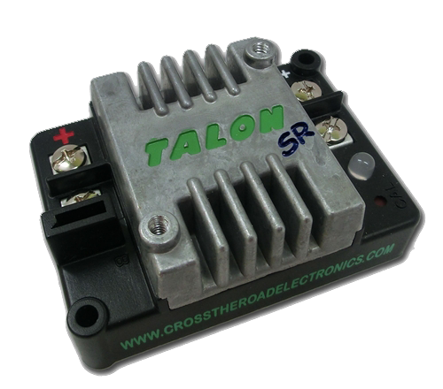
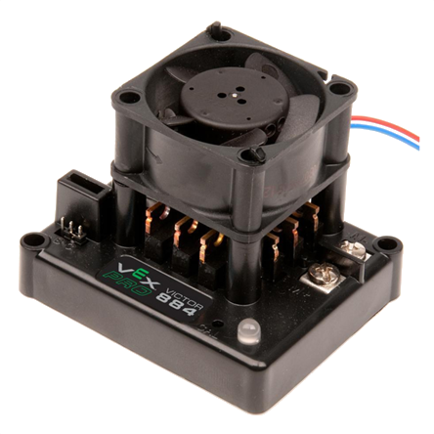
Electric Speed Controllers
Controls the current sent to the motors and the direction the motor turns.
Victor 888 ESC Jaguar ESC Talon ESC
Small, PWM Only
Large, PWM and CAN
Small, PWM Only

Slide 16
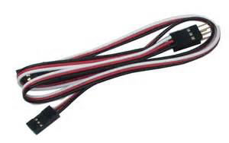
Pulse Width Modulation(PWM)
Pulse Width Modulation is used in two ways on our FIRST Robots:
To provide a varying amount of power to the motors.
To communicate with the Speed controller.
cRIO
ESC
ESC
ESC
ESC
ESC
ESC
ESC
ESC

Slide 17
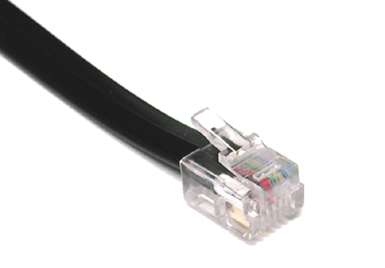
Controller Area Network(CAN)
“CAN” Stands for “Controller Area Network”
Is a single chain of point-to-point connections
The “bus” goes around the chain delivering the signal to different addresses – each ESC has its own address
cRIO
2 CAN
ESC
ESC
ESC
ESC
Telephone Wire
ESC
ESC
ESC
ESC

Slide 18
Power Distribution Diagram
18AWG
Speed Controller
100A
6AWG
40A
20A
12AWG
18AWG

